Slide 1
Quantitative Risk Management Lecture 6: Credit Risk
Roy E. DeMeo, Jr.

Slide 2
What is Credit Risk?
Credit risk has three flavors:
Changes in default probability due to market risk
Change in the credit rating of the company. This is known as migration.
Risk of actual defaults.

Slide 3
Where is it Most Important?
Most banks, such as Wells Fargo, has many large positions in credit-sensitive products, such as credit bonds, credit default swaps. We will not consider mortgages in this course. Certain regulatory risk measures, such as Incremental Risk Charge, which measures the risk on the previous slide
In addition, all positions have counterparty credit risk which is the risk that your counterparty will default (covered in another lecture).

Slide 4
Types of Credit Models
Structural Model – Looks at the value of the entire firm, and models default as happening when the firm is worth less than the outstanding debt
Reduced Form model – Models default as a jump process (Poisson process).

Slide 5
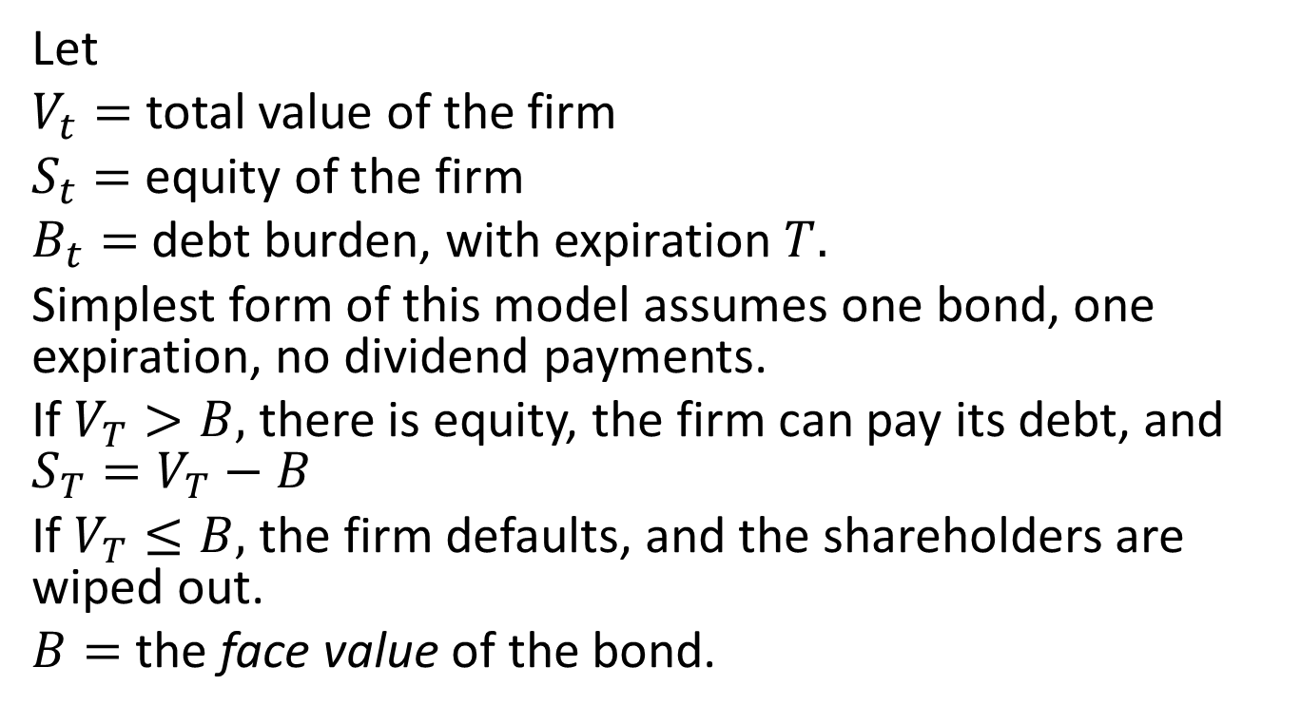
Merton Model
Let
$V_{t}=$ total value of the firm
$S_{t}=$ equity of the firm
$B_{t}=$debt burden, with expiration $T.$
Simplest form of this model assumes one bond, one expiration, no dividend payments.
If $V_{T}>B,$ there is equity, the firm can pay its debt, and $S_{T}=V_{T}−B$
If $V_{T}≤B,$ the firm defaults, and the shareholders are wiped out.
$B=$ the face value of the bond.

Slide 6
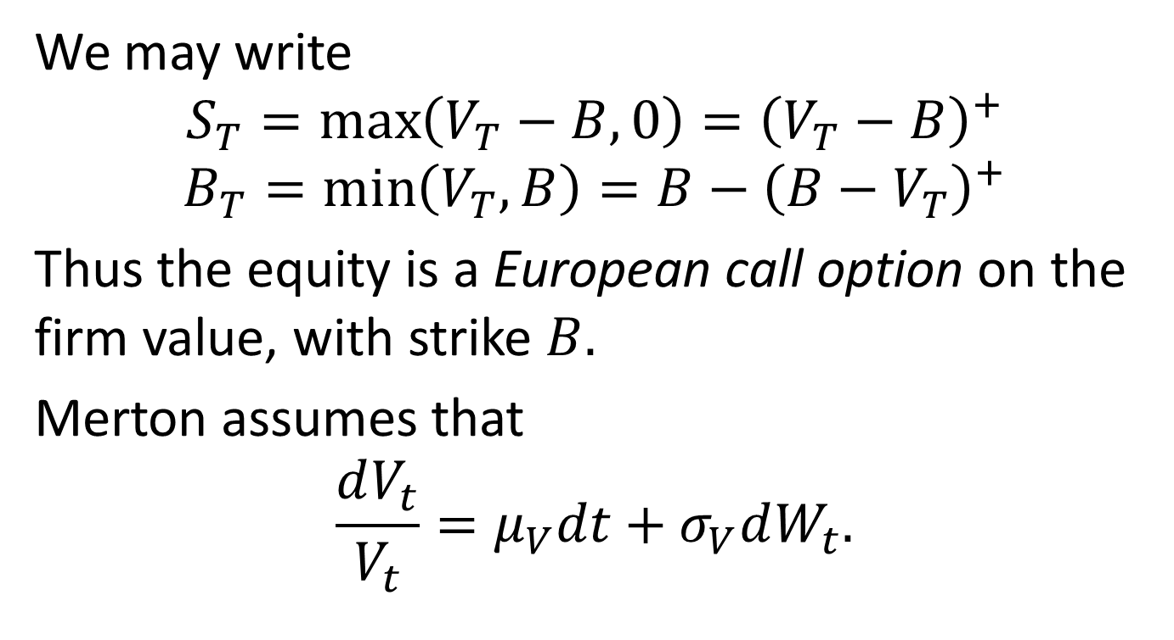
Merton Model, cont’d
We may write
$$S_{T}=\max\left(V_{T}−B,0\right)={\left(V_{T}−B\right)}^{+}$$
$$B_{T}=\min\left(V_{T},B\right)=B−{\left(B−V_{T}\right)}^{+}$$
Thus the equity is a European call option on the firm value, with strike $B.$
Merton assumes that
$$\frac{dV_{t}}{V_{t}}=μ_{V}dt+σ_{V}dW_{t}.$$

Slide 7
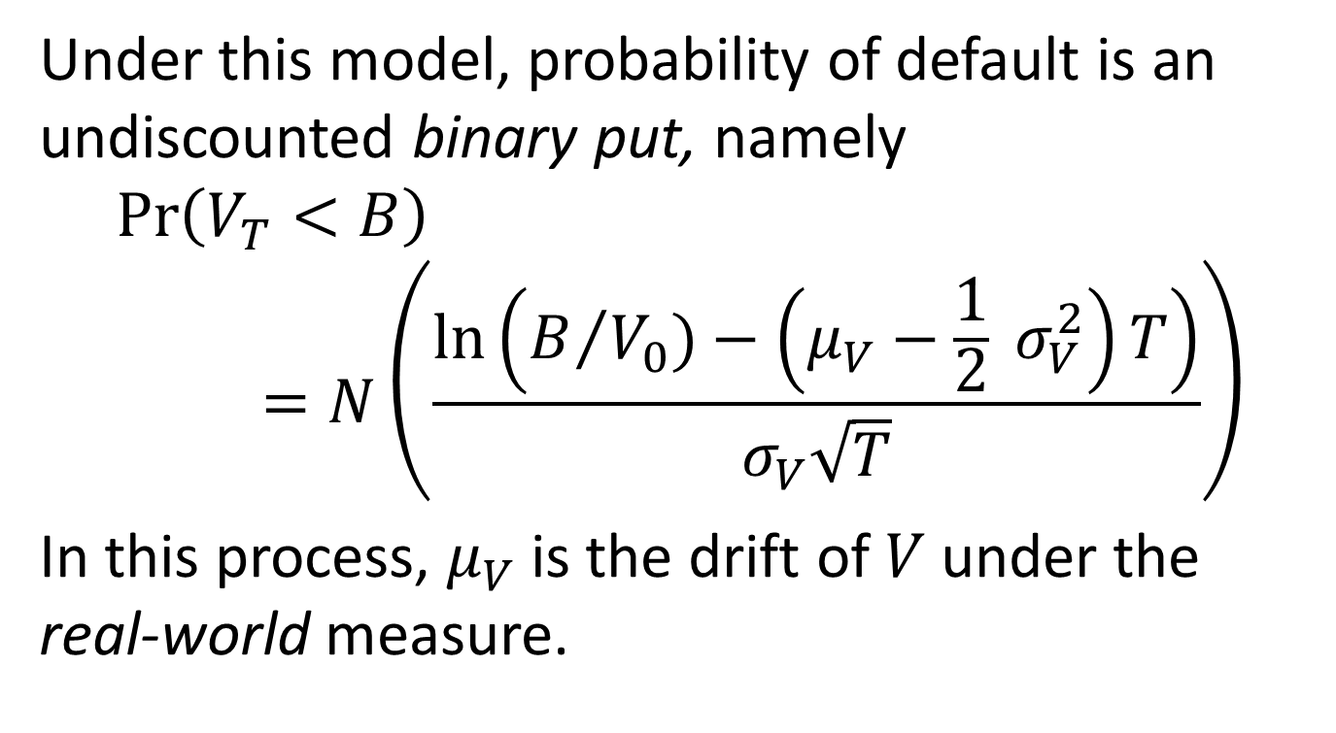
Default Probability
Under this model, probability of default is an undiscounted binary put, namely
$$\operatorname{Pr}\left(V_{T}<B\right)=N\left(\frac{\ln\left(B/{V_{0})}−\left(μ_{V}−\frac{1}{2} σ_{V}^{2}\right)T\right)}{σ_{V}\sqrt{T}}\right)$$
In this process, $μ_{V}$ is the drift of $V$under the real-world measure.

Slide 8
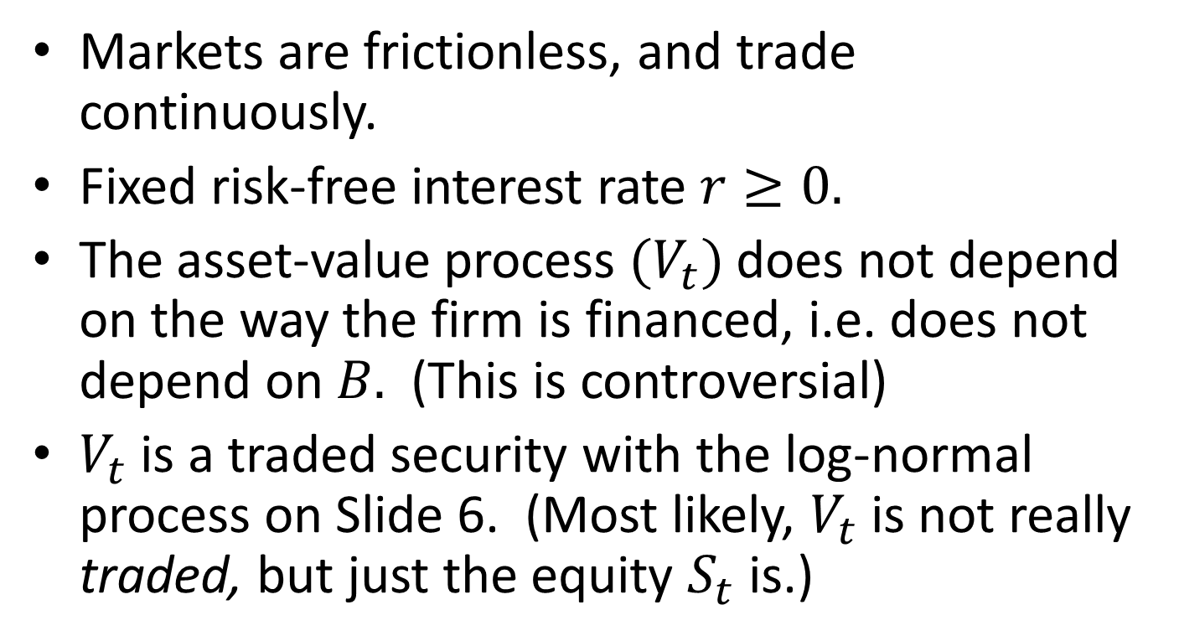
Merton’s Main Assumptions
Markets are frictionless, and trade continuously.
Fixed risk-free interest rate $r≥0.$
The asset-value process $(V_{t})$ does not depend on the way the firm is financed, i.e. does not depend on $B.$ (This is controversial)
$V_{t}$ is a traded security with the log-normal process on Slide 6. (Most likely, $V_{t}$ is not really traded, but just the equity $S_{t}$ is.)

Slide 9
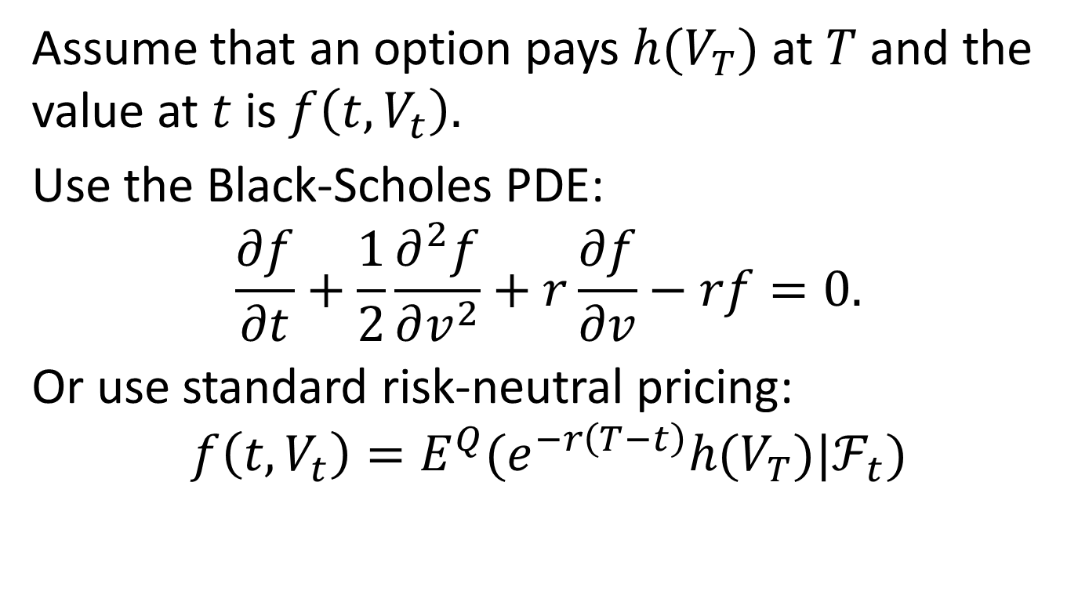

Pricing a Claim on $V_{t}$
Assume that an option pays $h(V_{T})$ at $T$ and the value at $t$ is $f\left(t,V_{t}\right).$
Use the Black-Scholes PDE:
$$\frac{∂f}{∂t}+\frac{1}{2}\frac{∂^{2}f}{∂v^{2}}+r\frac{∂f}{∂v}−rf=0.$$
Or use standard risk-neutral pricing:
$$f\left(t,V_{t}\right)=E^{Q}(e^{−r\left(T−t\right)}h(V_{T})|ℱ_{t})$$

Slide 10
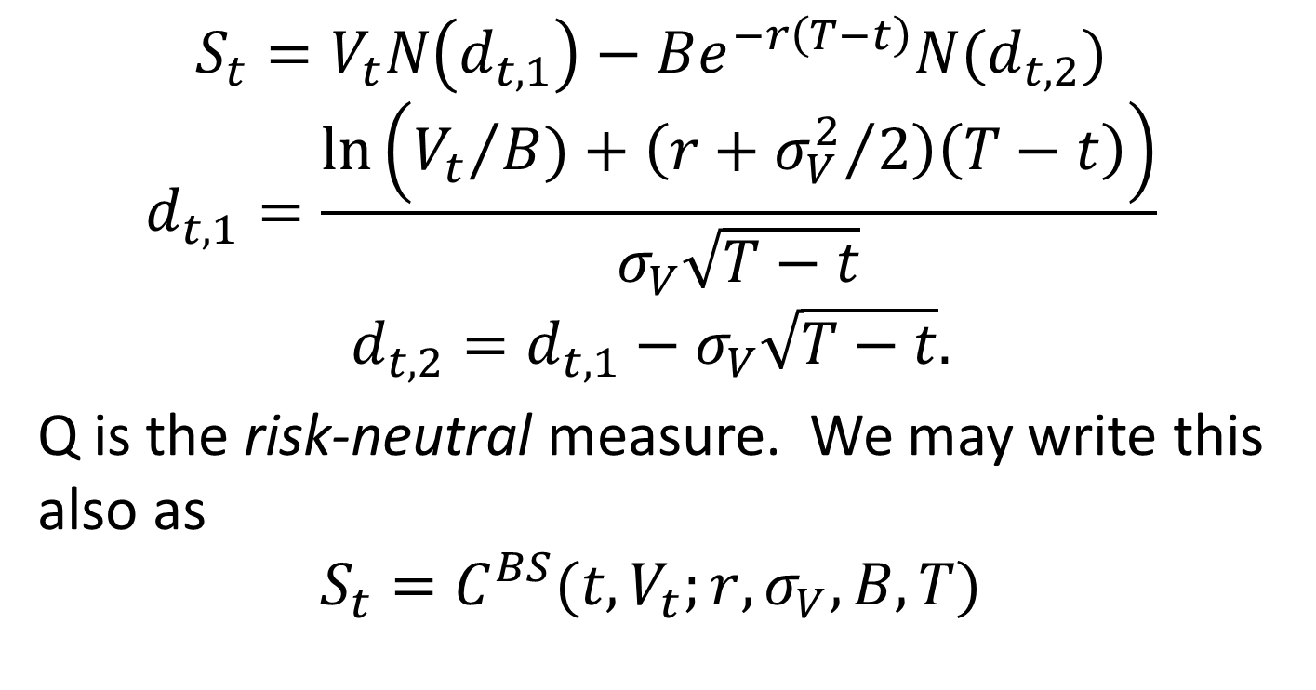
Stock is a Call Option on V
$$S_{t}=V_{t}N\left(d_{t,1}\right)−Be^{−r\left(T−t\right)}N(d_{t,2})$$
$$d_{t,1}=\frac{\ln\left({V_{t}}/{B)}+\left(r+{σ_{V}^{2}}/2\right)\left(T−t\right)\right)}{σ_{V}\sqrt{T−t}}$$
$$d_{t,2}=d_{t,1}−σ_{V}\sqrt{T−t}.$$
Q is the risk-neutral measure. We may write this also as
$$S_{t}=C^{BS}(t,V_{t};r,σ_{V},B,T)$$

Slide 11
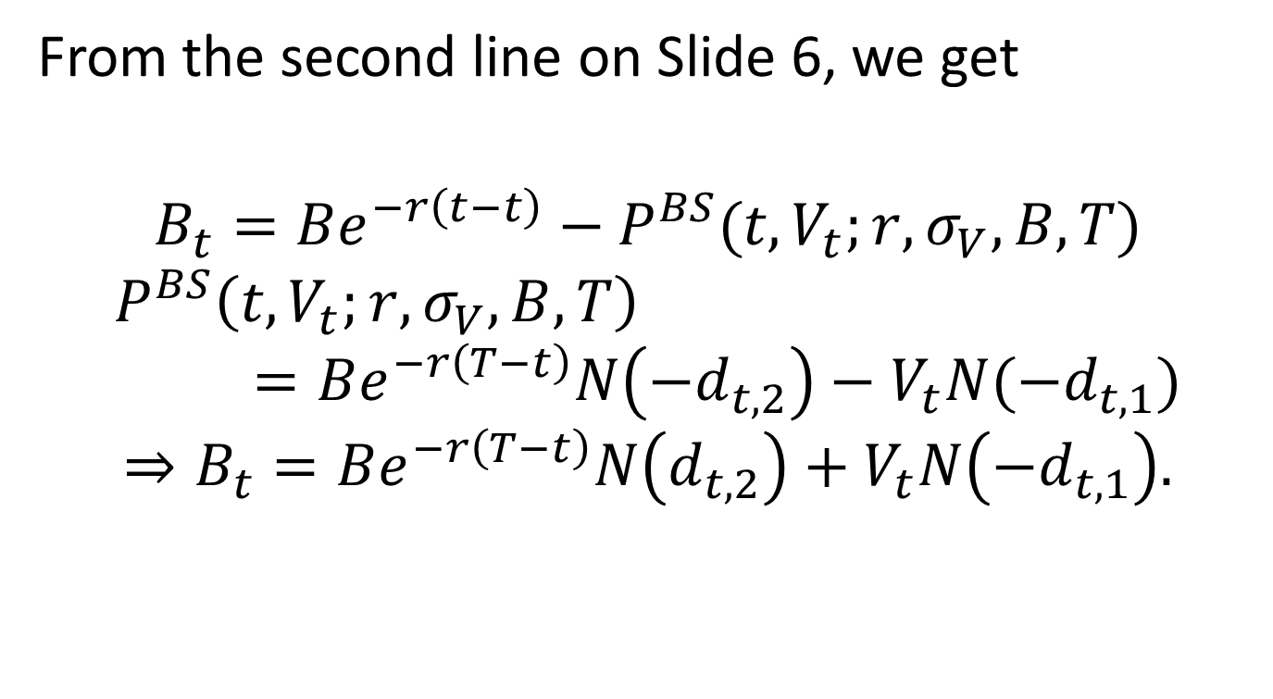
Debt in terms of a Put
From the second line on Slide 6, we get
$$B_{t}=Be^{−r\left(t−t\right)}−P^{BS}(t,V_{t};r,σ_{V},B,T)$$
$$P^{BS}\left(t,V_{t};r,σ_{V},B,T\right)=Be^{−r\left(T−t\right)}N\left(−d_{t,2}\right)−V_{t}N(−d_{t,1})$$
$$⇒B_{t}=Be^{−r\left(T−t\right)}N\left(d_{t,2}\right)+V_{t}N\left(−d_{t,1}\right).$$

Slide 12
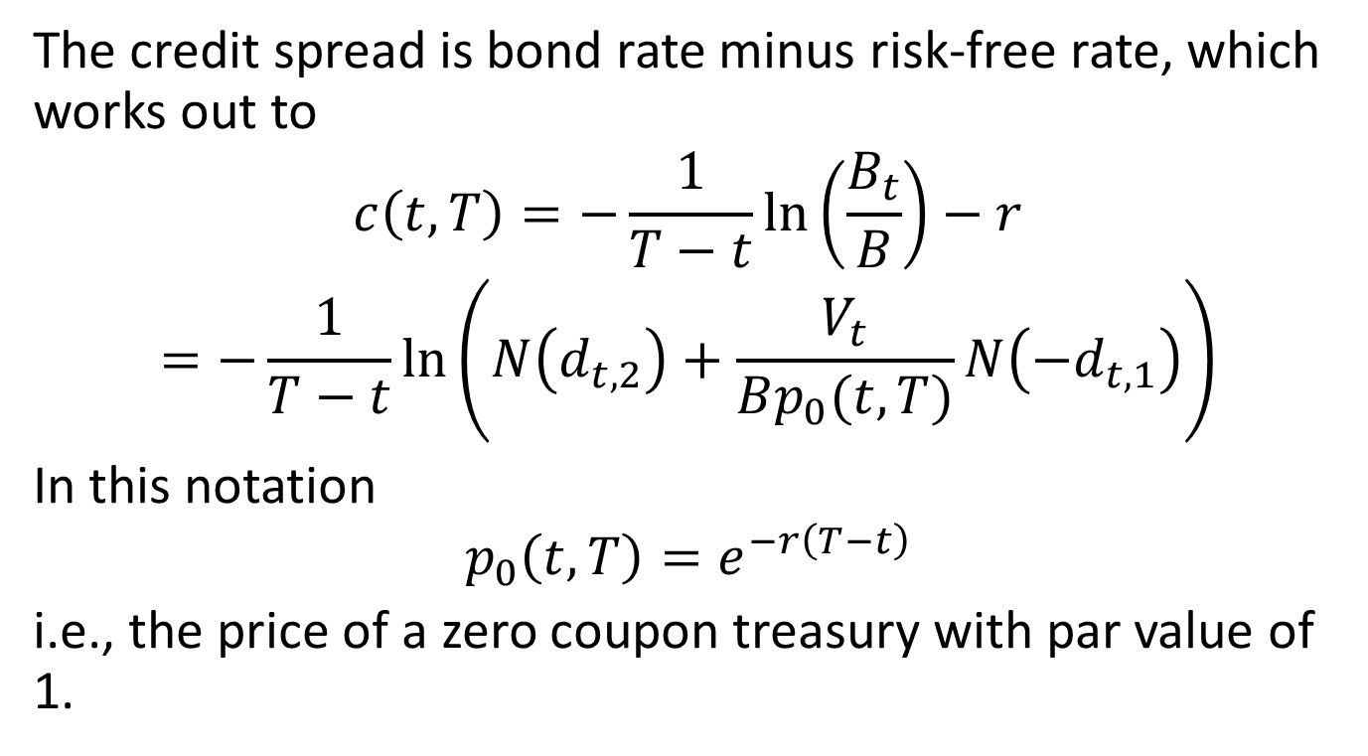
Deriving the Credit Spread
The credit spread is bond rate minus risk-free rate, which works out to
$$c\left(t,T\right)=−\frac{1}{T−t}\ln\left(\frac{B_{t}}{B}\right)−r$$
$$=−\frac{1}{T−t}\ln\left(N\left(d_{t,2}\right)+\frac{V_{t}}{Bp_{0}(t,T)}N\left(−d_{t,1}\right)\right)$$
In this notation
$$p_{0}\left(t,T\right)=e^{−r\left(T−t\right)}$$
i.e., the price of a zero coupon treasury with par value of 1.

Slide 13
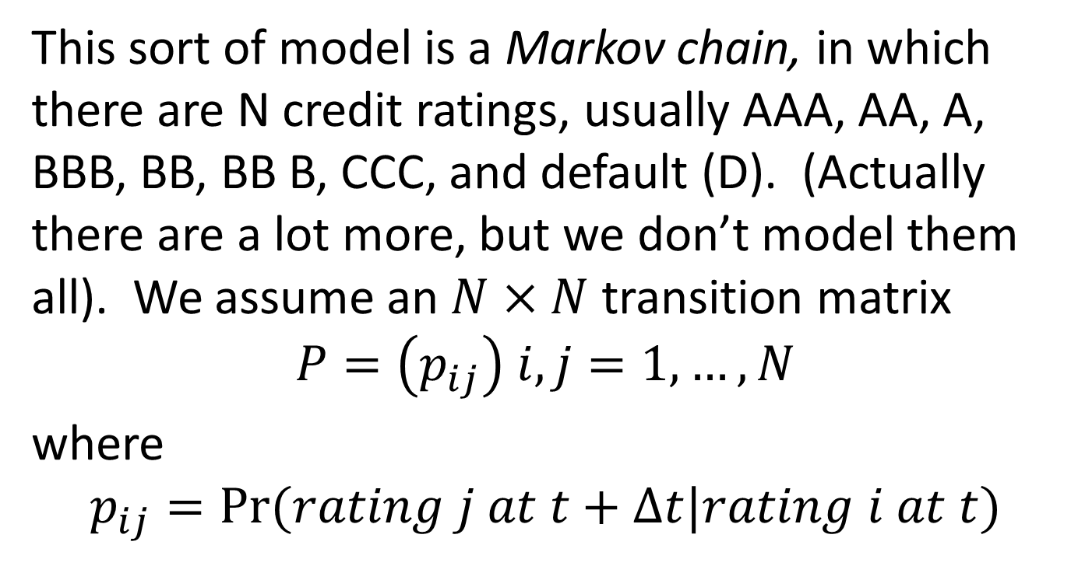
Credit Migration Model
This sort of model is a Markov chain, in which there are N credit ratings, usually AAA, AA, A, BBB, BB, BB B, CCC, and default (D). (Actually there are a lot more, but we don’t model them all). We assume an $N×N$ transition matrix
$$P=\left(p_{ij}\right) i,j=1,…,N$$
where
$$p_{ij}=Pr⁡(rating j at t+Δt|rating i at t)$$

Slide 14

Transition Matrix Example
The probabilities below are expressed in percentage terms. The horizon is 1 year ($ΔT=1).$

Slide 15
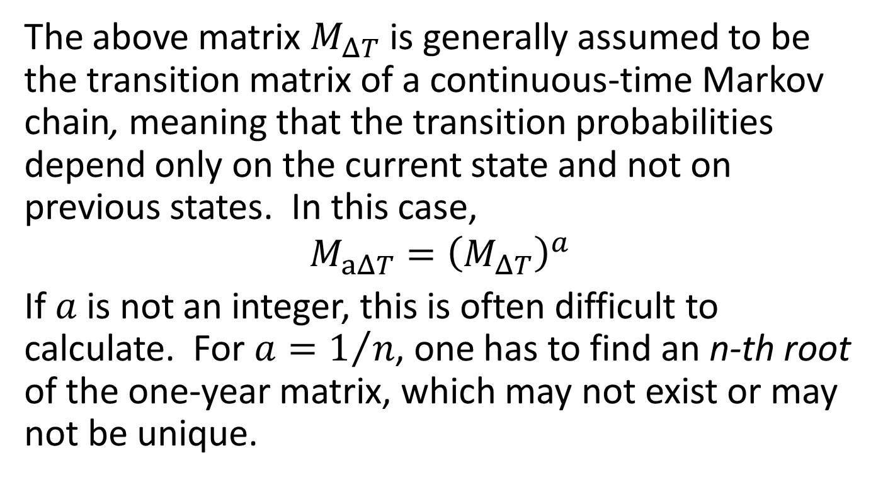
Markov chain assumption
The above matrix $M_{ΔT}$ is generally assumed to be the transition matrix of a continuous-time Markov chain, meaning that the transition probabilities depend only on the current state and not on previous states. In this case,
$$M_{aΔT}={\left(M_{ΔT}\right)}^{a}$$
If $a$is not an integer, this is often difficult to calculate. For $a=1/n$, one has to find an n-th root of the one-year matrix, which may not exist or may not be unique.

Slide 16
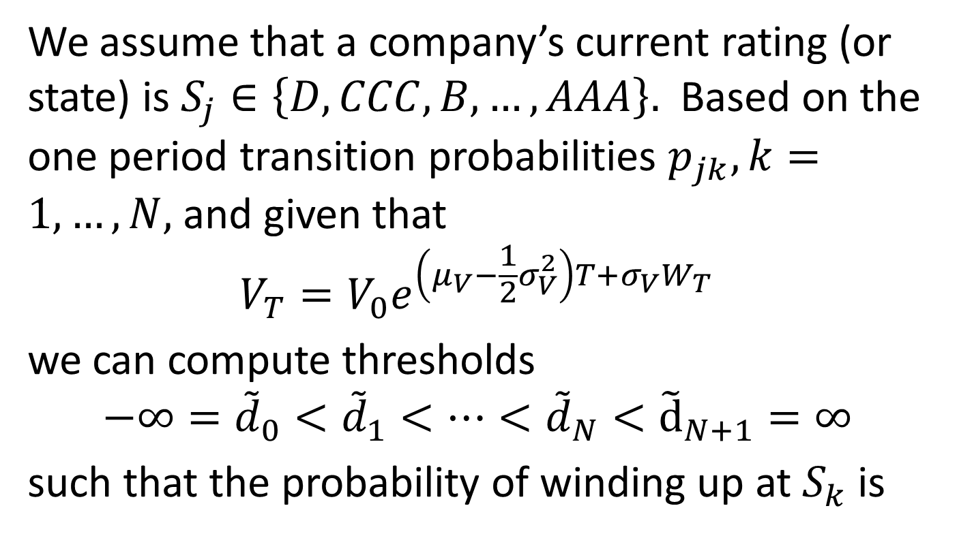
Migrations as thresholds
We assume that a company’s current rating (or state) is $S_{j}∈\left\{D,CCC,B,…,AAA\right\}.$ Based on the one period transition probabilities $p_{jk}, k=1,…,N,$ and given that
$$V_{T}=V_{0}e^{\left(μ_{V}−\frac{1}{2}σ_{V}^{2}\right)T+σ_{V}W_{T}}$$
we can compute thresholds
$$−∞={\tilde{d}}_{0}<{\tilde{d}}_{1}<…<{\tilde{d}}_{N}<{\tilde{d}}_{N+1}=∞$$
such that the probability of winding up at $S_{k}$ is

Slide 17

Migrations as thresholds, cont’d
$$\operatorname{Pr}\left({\tilde{d}}_{k}<V_{T}≤{\tilde{d}}_{k+1}\right)=p_{jk}.$$
To calculate the ${\tilde{d}}_{k}$’s exactly, we go to the doc cam….

Slide 18
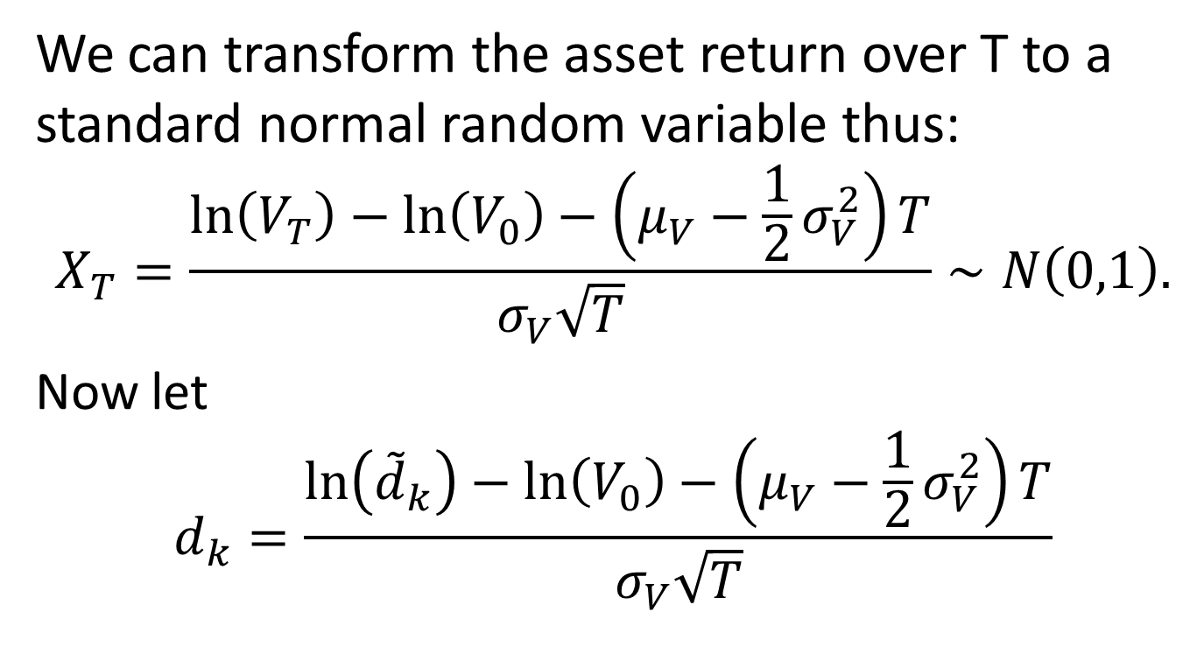
Migration thresholds, cont’d
We can transform the asset return over T to a standard normal random variable thus:
$$X_{T}=\frac{\ln\left(V_{T}\right)−\ln\left(V_{0}\right)−\left(μ_{V}−\frac{1}{2}σ_{V}^{2}\right)T}{σ_{V}\sqrt{T}}∼N\left(0,1\right).$$
Now let
$$d_{k}=\frac{\ln\left({\tilde{d}}_{k}\right)−\ln\left(V_{0}\right)−\left(μ_{V}−\frac{1}{2}σ_{V}^{2}\right)T}{σ_{V}\sqrt{T}}$$

Slide 19
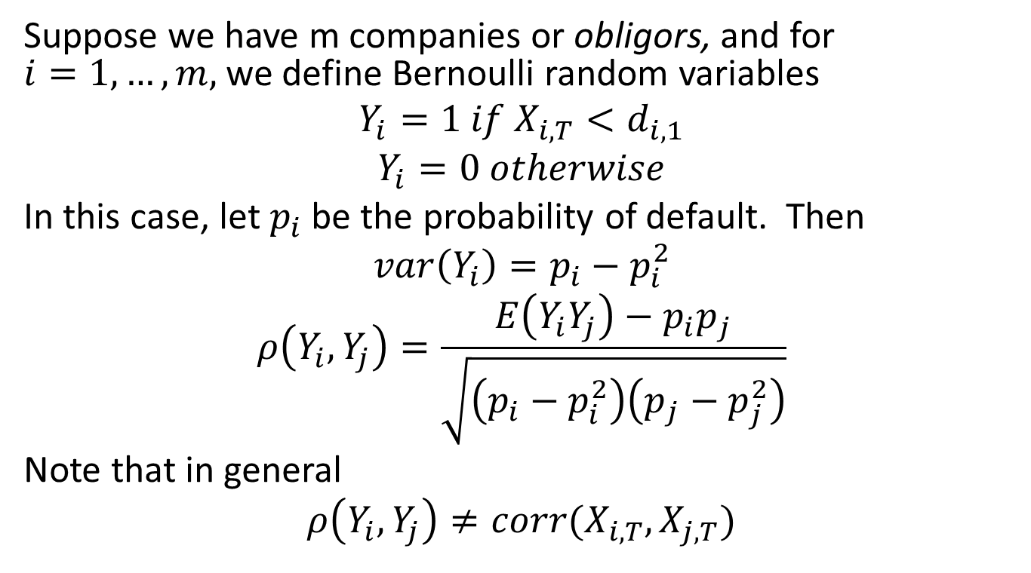
Default Correlation
Suppose we have m companies or obligors, and for $i=1,…,m,$ we define Bernoulli random variables
$$Y_{i}=1 if X_{i,T}<d_{i,1}$$
$$Y_{i}=0 otherwise$$
In this case, let $p_{i}$ be the probability of default. Then
$$var\left(Y_{i}\right)=p_{i}−p_{i}^{2}$$
$$ρ\left(Y_{i},Y_{j}\right)=\frac{E\left(Y_{i}Y_{j}\right)−p_{i}p_{j}}{\sqrt{\left(p_{i}−p_{i}^{2}\right)\left(p_{j}−p_{j}^{2}\right)}}$$
Note that in general
$$ρ\left(Y_{i},Y_{j}\right)≠corr(X_{i,T},X_{j,T})$$

Slide 20
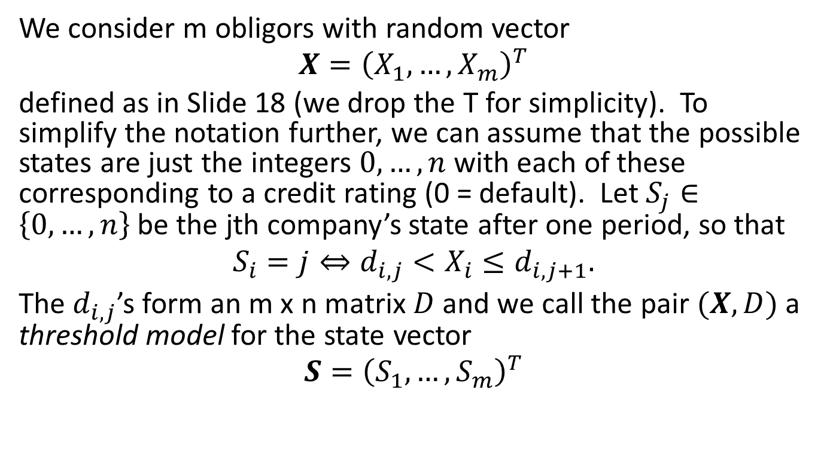
Multivariate Threshold Models
We consider m obligors with random vector
$$X={\left(X_{1},…,X_{m}\right)}^{T}$$
defined as in Slide 18 (we drop the T for simplicity). To simplify the notation further, we can assume that the possible states are just the integers $0,…,n$ with each of these corresponding to a credit rating (0 = default). Let $S_{j}∈\left\{0,…,n\right\}$be the jth company’s state after one period, so that
$$S_{i}=j⇔d_{i,j}<X_{i}≤d_{i,j+1}.$$
The $d_{i,j}$’s form an m x n matrix $D$and we call the pair $(X,D)$ a threshold model for the state vector
$$S={\left(S_{1},…,S_{m}\right)}^{T}$$

Slide 21
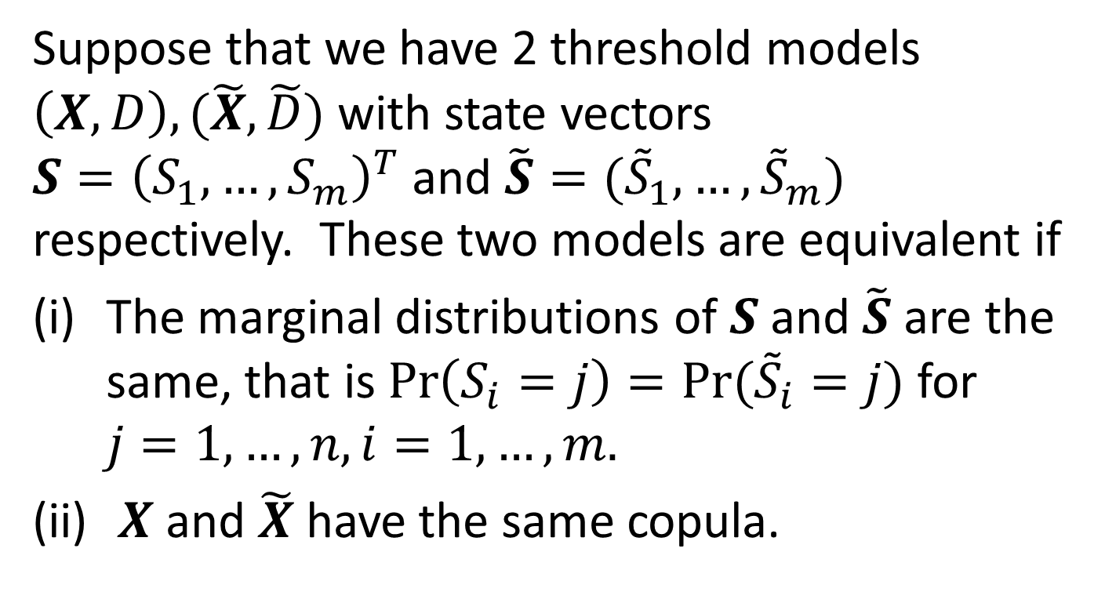
Equivalent Threshold Models
Suppose that we have 2 threshold models $\left(X,D\right), (\tilde{X},\tilde{D})$ with state vectors $S={\left(S_{1},…,S_{m}\right)}^{T}$ and $\tilde{S}=({\tilde{S}}_{1},…,{\tilde{S}}_{m})$ respectively. These two models are equivalent if
The marginal distributions of $S$and $\tilde{S}$ are the same, that is $\operatorname{Pr}\left(S_{i}=j\right)=Pr⁡({\tilde{S}}_{i}=j)$ for $j=1,…,n, i=1,…,m.$
$X$and $\tilde{X}$ have the same copula.

Slide 22
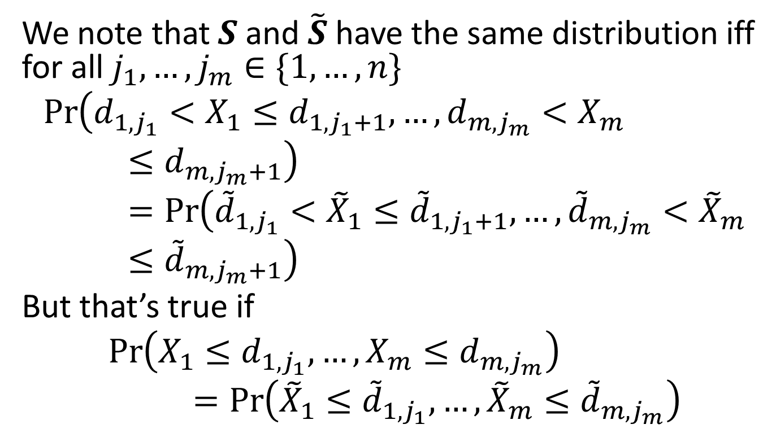
Equivalent Threshold Models, cont’d
We note that $S$and $\tilde{S}$ have the same distribution iff for all $j_{1},…,j_{m}∈\{1,…,n\}$
$$\operatorname{Pr}\left(d_{1,j_{1}}<X_{1}≤d_{1,j_{1}+1},…,d_{m,j_{m}}<X_{m}≤d_{m,j_{m}+1}\right)=\operatorname{Pr}\left({\tilde{d}}_{1,j_{1}}<{\tilde{X}}_{1}≤{\tilde{d}}_{1,j_{1}+1},…,{\tilde{d}}_{m,j_{m}}<{\tilde{X}}_{m}≤{\tilde{d}}_{m,j_{m}+1}\right)$$
But that’s true if
$$\operatorname{Pr}\left(X_{1}≤d_{1,j_{1}},…,X_{m}≤d_{m,j_{m}}\right)=\operatorname{Pr}\left({\tilde{X}}_{1}≤{\tilde{d}}_{1,j_{1}},…,{\tilde{X}}_{m}≤{\tilde{d}}_{m,j_{m}}\right)$$

Slide 23
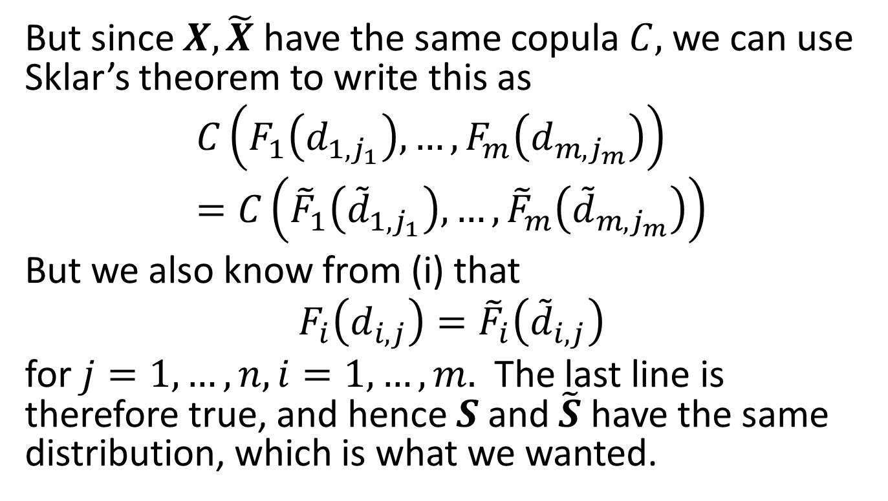
Equivalent Threshold Models, cont’d
But since $X,\tilde{X}$ have the same copula $C,$ we can use Sklar’s theorem to write this as
$$C\left(F_{1}\left(d_{1,j_{1}}\right),…,F_{m}\left(d_{m,j_{m}}\right)\right)=C\left({\tilde{F}}_{1}\left({\tilde{d}}_{1,j_{1}}\right),…,{\tilde{F}}_{m}\left({\tilde{d}}_{m,j_{m}}\right)\right)$$
But we also know from (i) that
$$F_{i}\left(d_{i,j}\right)={\tilde{F}}_{i}\left({\tilde{d}}_{i,j}\right)$$
for $j=1,…,n, i=1,…,m.$ The last line is therefore true, and hence $S$ and $\tilde{S}$ have the same distribution, which is what we wanted.

Slide 24
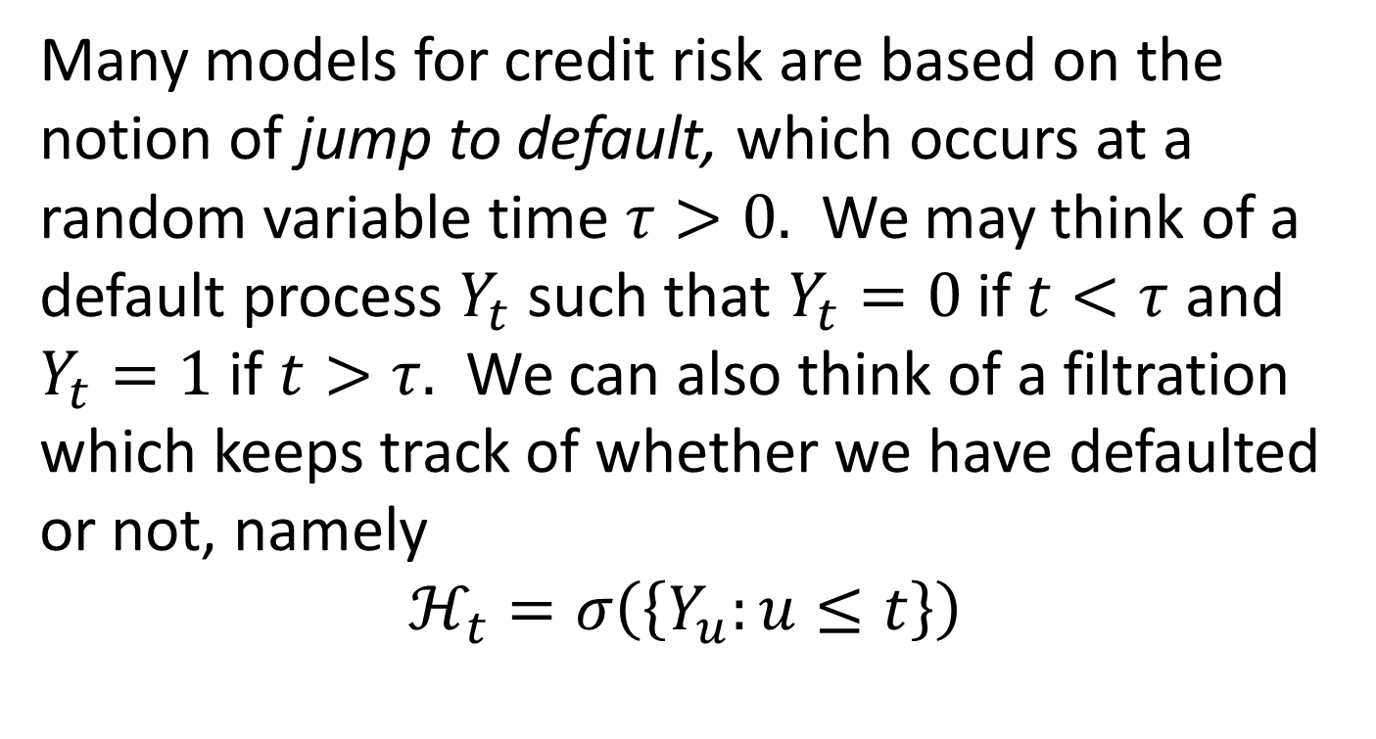
Reduced Form Models
Many models for credit risk are based on the notion of jump to default, which occurs at a random variable time $τ>0.$ We may think of a default process $Y_{t}$ such that $Y_{t}=0$if $t<τ$ and $Y_{t}=1$ if $t>τ.$ We can also think of a filtration which keeps track of whether we have defaulted or not, namely
$$ℋ_{t}=σ\left(\left\{Y_{u}:u≤t\right\}\right)$$

Slide 25
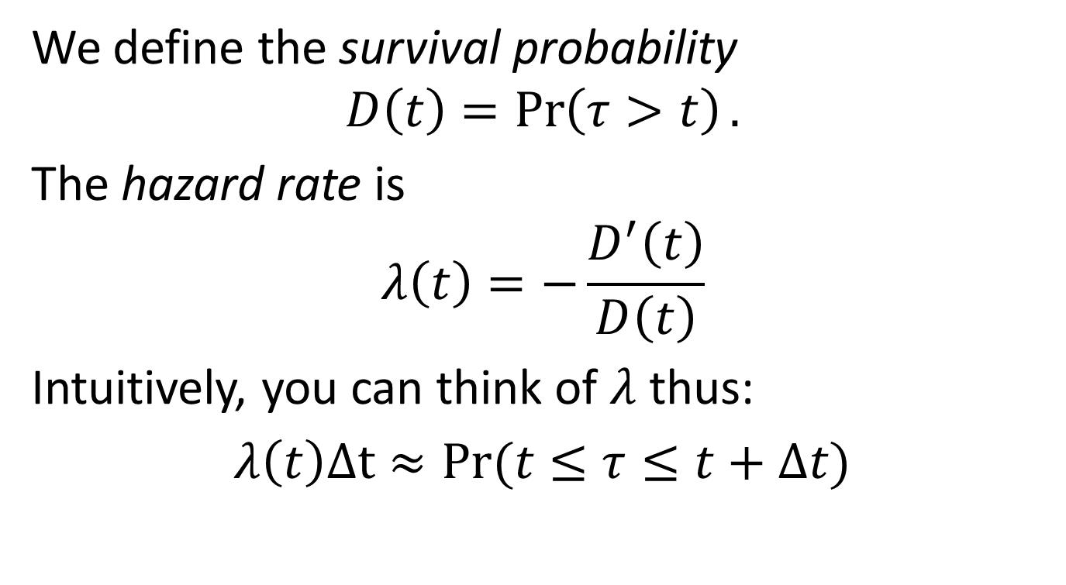
Reduced Form, cont’d
We define the survival probability
$$D\left(t\right)=\operatorname{Pr}\left(τ>t\right).$$
The hazard rate is
$$λ\left(t\right)=−\frac{D^{′}\left(t\right)}{D\left(t\right)}$$
Intuitively, you can think of $λ$ thus:
$λ\left(t\right)Δt≈Pr⁡(t≤τ≤t+Δt)$

Slide 26
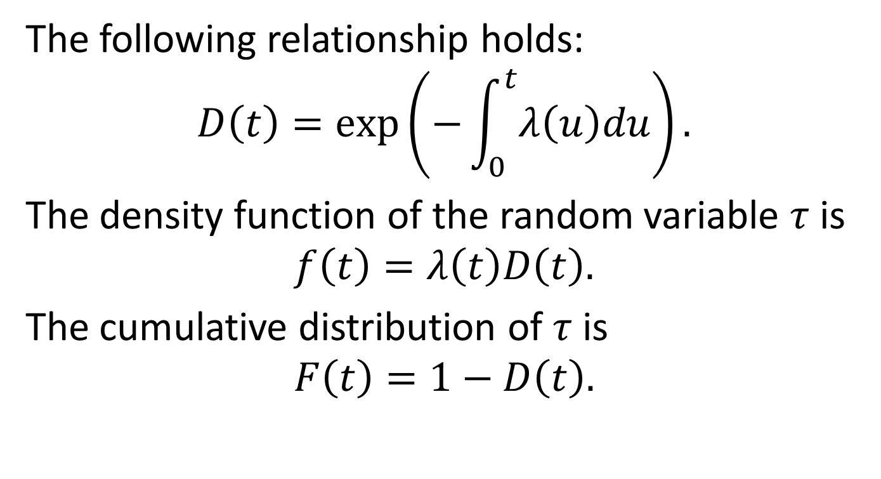
More on Survival
The following relationship holds:
$$D\left(t\right)=\exp\left(−\int_{0}^{t}{λ\left(u\right)du}\right).$$
The density function of the random variable $τ$ is
$$f\left(t\right)=λ\left(t\right)D\left(t\right).$$
The cumulative distribution of $τ$ is
$$F\left(t\right)=1−D\left(t\right).$$

Slide 27
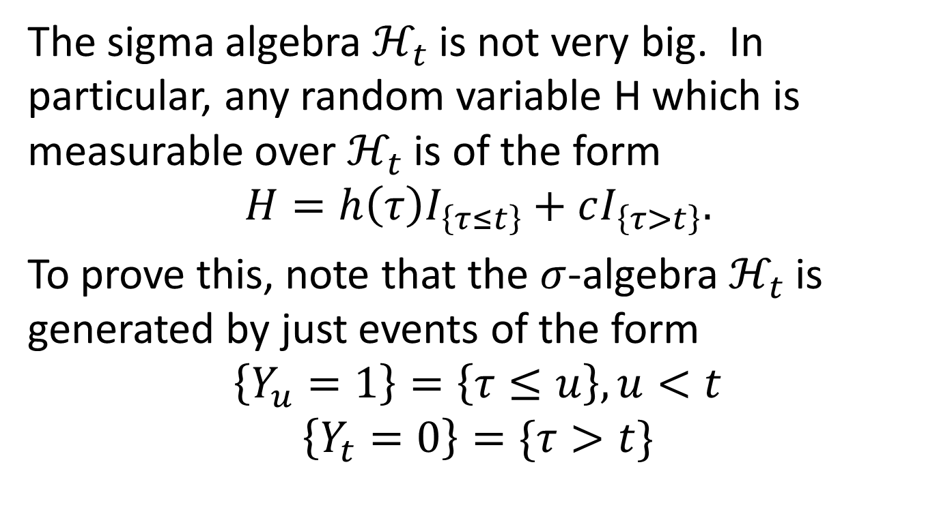
More on the Default Filtration
The sigma algebra $ℋ_{t}$ is not very big. In particular, any random variable H which is measurable over $ℋ_{t}$ is of the form
$$H=h\left(τ\right)I_{\left\{τ≤t\right\}}+cI_{\left\{τ>t\right\}}.$$
To prove this, note that the $σ$-algebra $ℋ_{t}$ is generated by just events of the form
$$\left\{Y_{u}=1\right\}=\left\{τ≤u\right\}, u<t$$
$$\left\{Y_{t}=0\right\}=\{τ>t\}$$

Slide 28
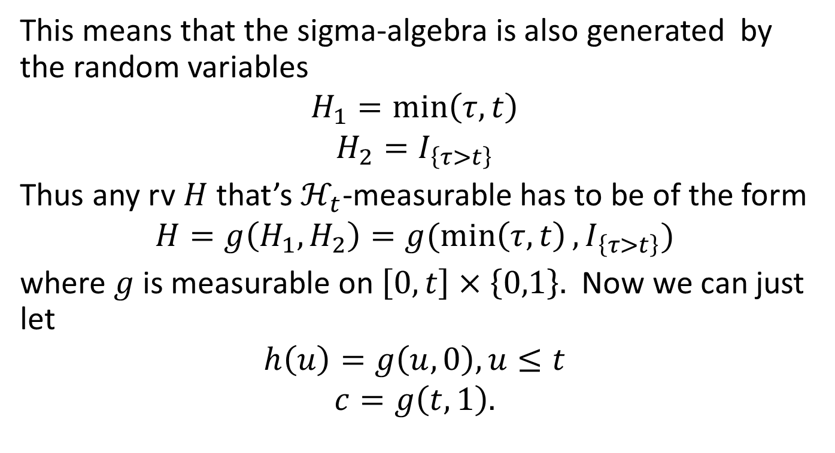
Default Filtration, cont’d
This means that the sigma-algebra is also generated by the random variables
$$H_{1}=\min\left(τ,t\right)$$
$$H_{2}=I_{\left\{τ>t\right\}}$$
Thus any rv $H$ that’s $ℋ_{t}$-measurable has to be of the form
$$H=g\left(H_{1},H_{2}\right)=g(\min\left(τ,t\right),I_{\left\{τ>t\right\}})$$
where $g$is measurable on $\left[0,t\right]×\left\{0,1\right\}.$ Now we can just let
$$h\left(u\right)=g\left(u,0\right), u≤t$$
$$c=g\left(t,1\right).$$

Slide 29
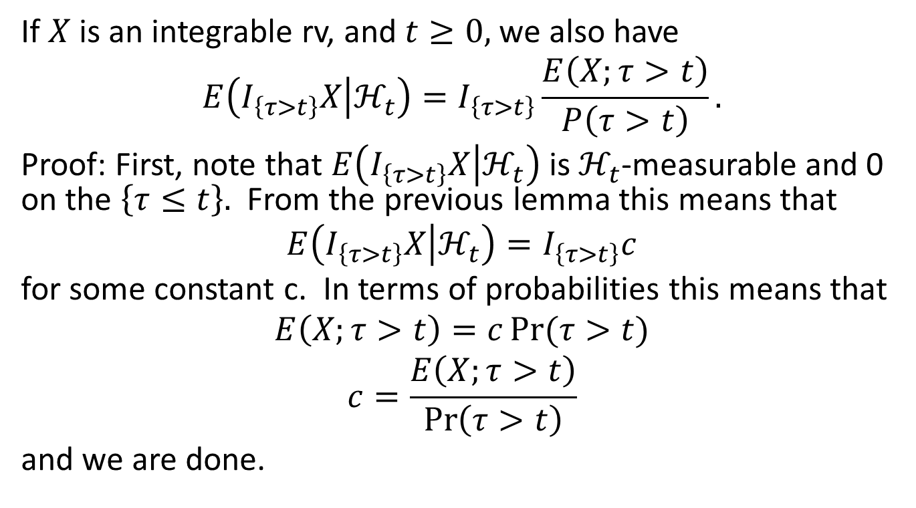
Another Lemma
If $X$is an integrable rv, and $t≥0,$ we also have
$$E\left(I_{\left\{τ>t\right\}}X | ℋ_{t}\right)=I_{\left\{τ>t\right\}}\frac{E\left(X;τ>t\right)}{P\left(τ>t\right)}.$$
Proof: First, note that $E\left(I_{\left\{τ>t\right\}}X | ℋ_{t}\right)$is $ℋ_{t}$-measurable and 0 on the $\left\{τ≤t\right\}.$ From the previous lemma this means that
$$E\left(I_{\left\{τ>t\right\}}X | ℋ_{t}\right)=I_{\left\{τ>t\right\}}c$$
for some constant c. In terms of probabilities this means that
$$E\left(X;τ>t\right)=c\operatorname{Pr}{(τ>t)}$$
$$c=\frac{E\left(X;τ>t\right)}{\operatorname{Pr}\left(τ>t\right)}$$
and we are done.

Slide 30
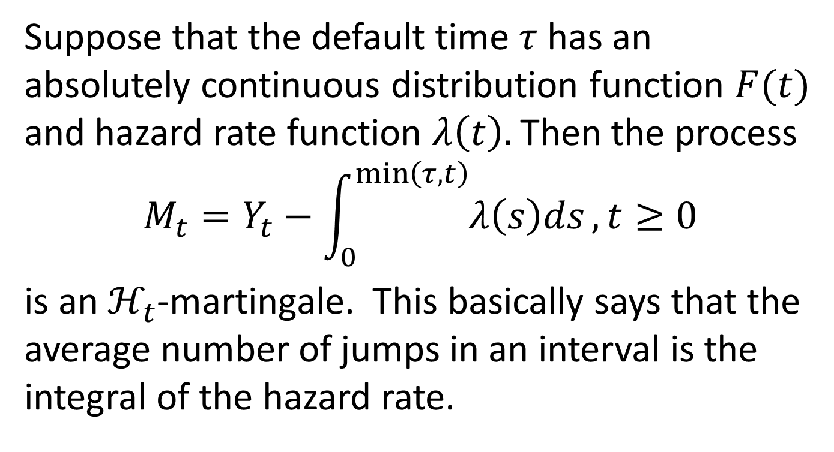
A Martingale Theorem
Suppose that the default time $τ$ has an absolutely continuous distribution function $F(t)$ and hazard rate function $λ\left(t\right).$Then the process
$$M_{t}=Y_{t}−\int_{0}^{\min\left(τ,t\right)}{λ\left(s\right)ds}, t≥0$$
is an $ℋ_{t}$-martingale. This basically says that the average number of jumps in an interval is the integral of the hazard rate.

Slide 31
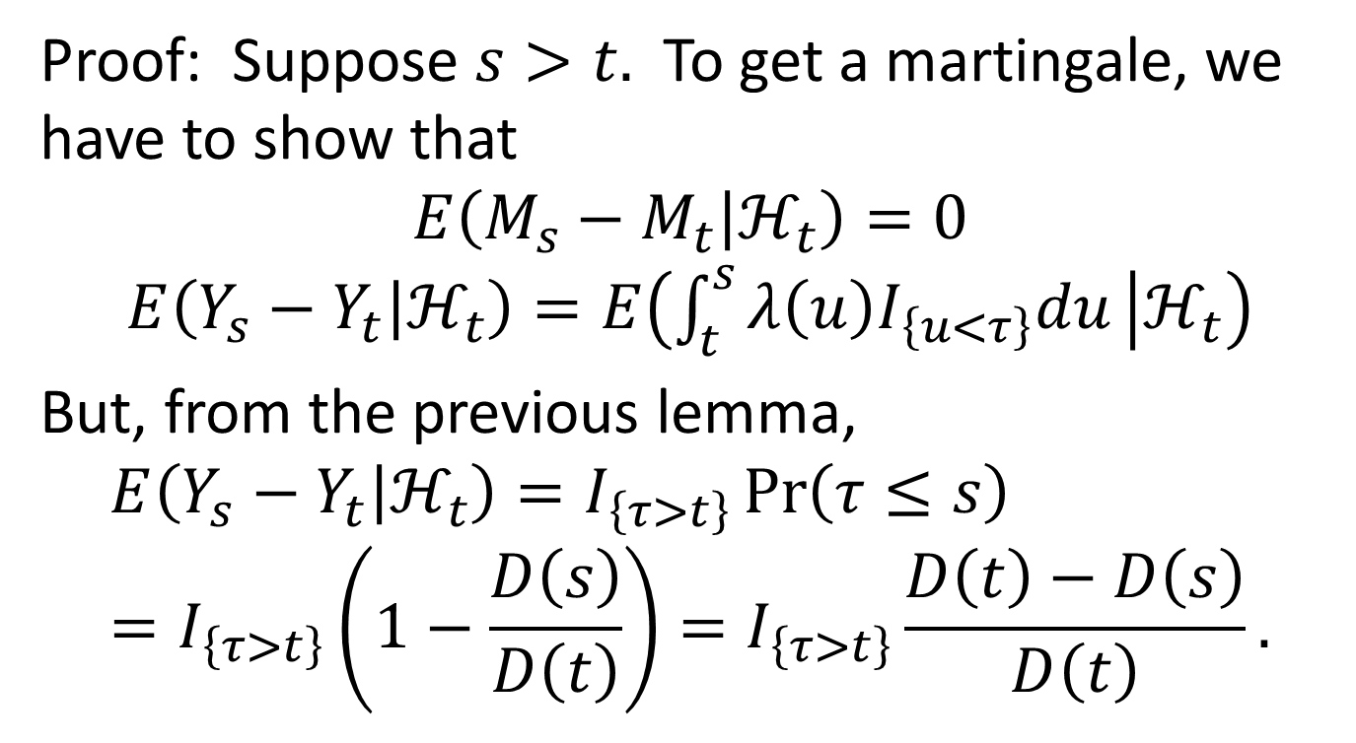
Martingale Theorem, cont’d
Proof: Suppose $s>t.$ To get a martingale, we have to show that
$$E\left(M_{s}−M_{t} | ℋ_{t}\right)=0$$
$$E\left(Y_{s}−Y_{t} | ℋ_{t}\right)=E\left(\int_{t}^{s}{λ\left(u\right)I_{\left\{u<τ\right\}}du} | ℋ_{t}\right)$$
But, from the previous lemma,
$$E\left(Y_{s}−Y_{t} | ℋ_{t}\right)=I_{\left\{τ>t\right\}}\operatorname{Pr}\left(τ≤s\right)=I_{\left\{τ>t\right\}}\left(1−\frac{D\left(s\right)}{D\left(t\right)}\right)=I_{\left\{τ>t\right\}}\frac{D\left(t\right)−D\left(s\right)}{D\left(t\right)}.$$

Slide 32
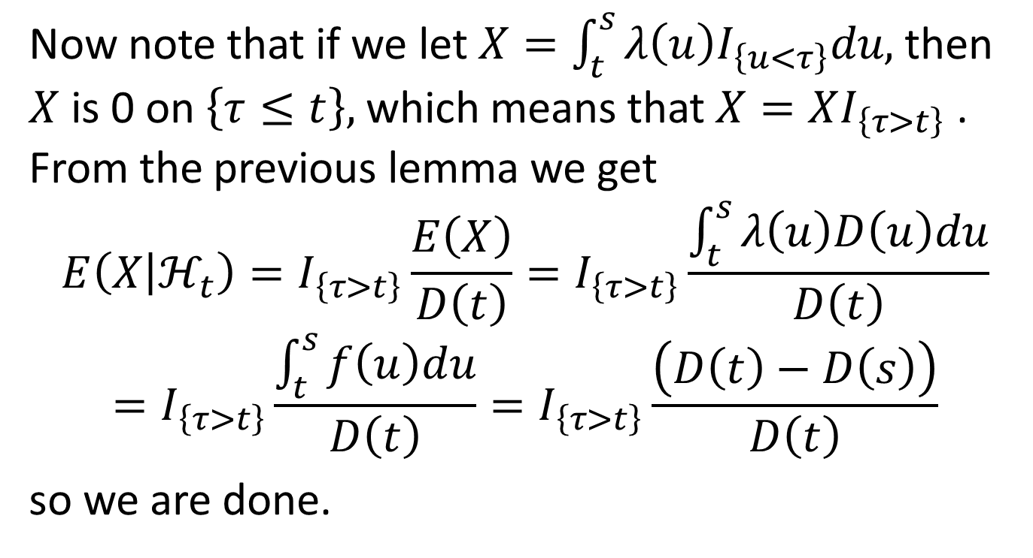
Martingale Theorem, cont’d
Now note that if we let $X=\int_{t}^{s}{λ\left(u\right)I_{\left\{u<τ\right\}}du,}$then $X$is 0 on $\left\{τ≤t\right\},$ which means that $X=XI_{\left\{τ>t\right\}}$ . From the previous lemma we get
$$E\left(X | ℋ_{t}\right)=I_{\left\{τ>t\right\}}\frac{E\left(X\right)}{D\left(t\right)}=I_{\left\{τ>t\right\}}\frac{\int_{t}^{s}{λ\left(u\right)D\left(u\right)du}}{D\left(t\right)}$$
$$=I_{\left\{τ>t\right\}}\frac{\int_{t}^{s}{f\left(u\right)du}}{D\left(t\right)}=I_{\left\{τ>t\right\}}\frac{\left(D\left(t\right)−D\left(s\right)\right)}{D\left(t\right)}$$
so we are done.

Slide 33
VaR for Credit Products
Value at risk for credit products (credit default swaps, risky corporate bonds, CDOs) is different from VaR for other products, because we exclude the effects of default and migration. We include those in a separate calculation known as Incremental Risk Charge, or IRC. We will describe IRC in detail in separate sheets.

Slide 34
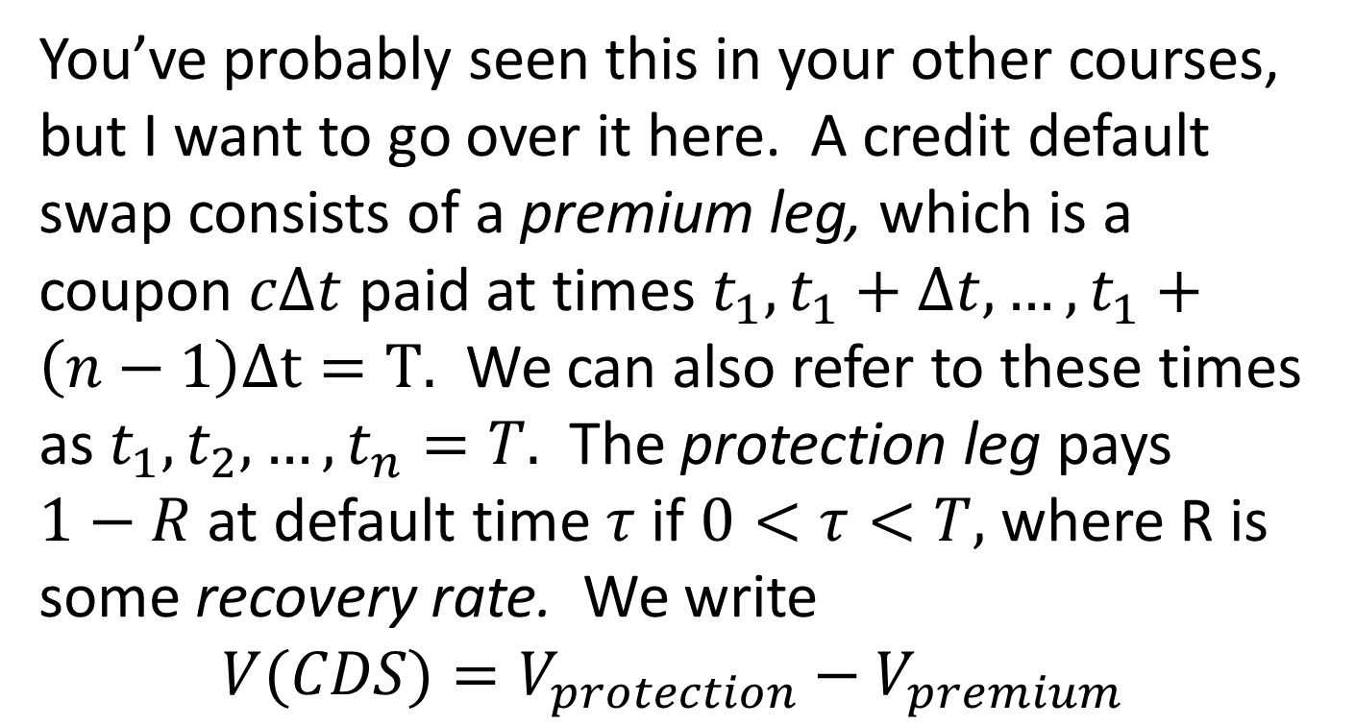
Quick Review of CDSs, Risky Bonds
You’ve probably seen this in your other courses, but I want to go over it here. A credit default swap consists of a premium leg, which is a coupon $cΔt$ paid at times $t_{1},t_{1}+Δt,…,t_{1}+\left(n−1\right)Δt=T.$ We can also refer to these times as $t_{1},t_{2},…,t_{n}=T.$ The protection leg pays $1−R$at default time $τ$ if $0<τ<T,$ where R is some recovery rate. We write
$$V(CDS)=V_{protection}−V_{premium}$$

Slide 35
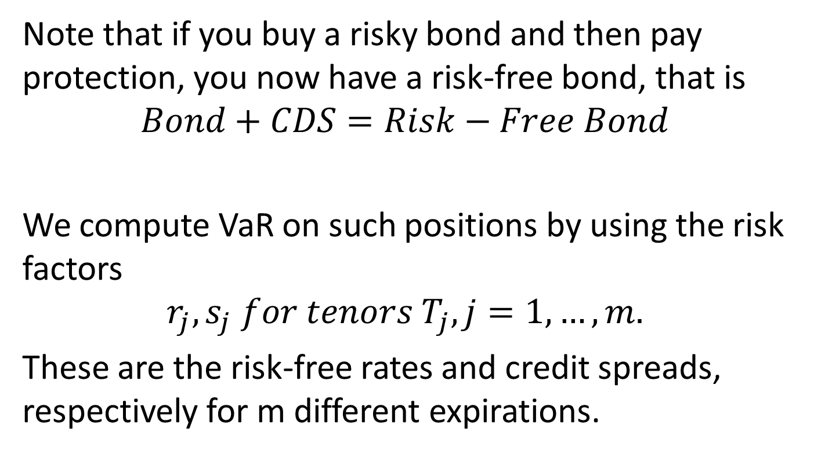
CDSs, Risky Bonds, cont’d
Note that if you buy a risky bond and then pay protection, you now have a risk-free bond, that is
$$Bond+CDS=Risk−Free Bond$$
We compute VaR on such positions by using the risk factors
$$r_{j},s_{j} for tenors T_{j}, j=1,…,m.$$
These are the risk-free rates and credit spreads, respectively for m different expirations.

Slide 36
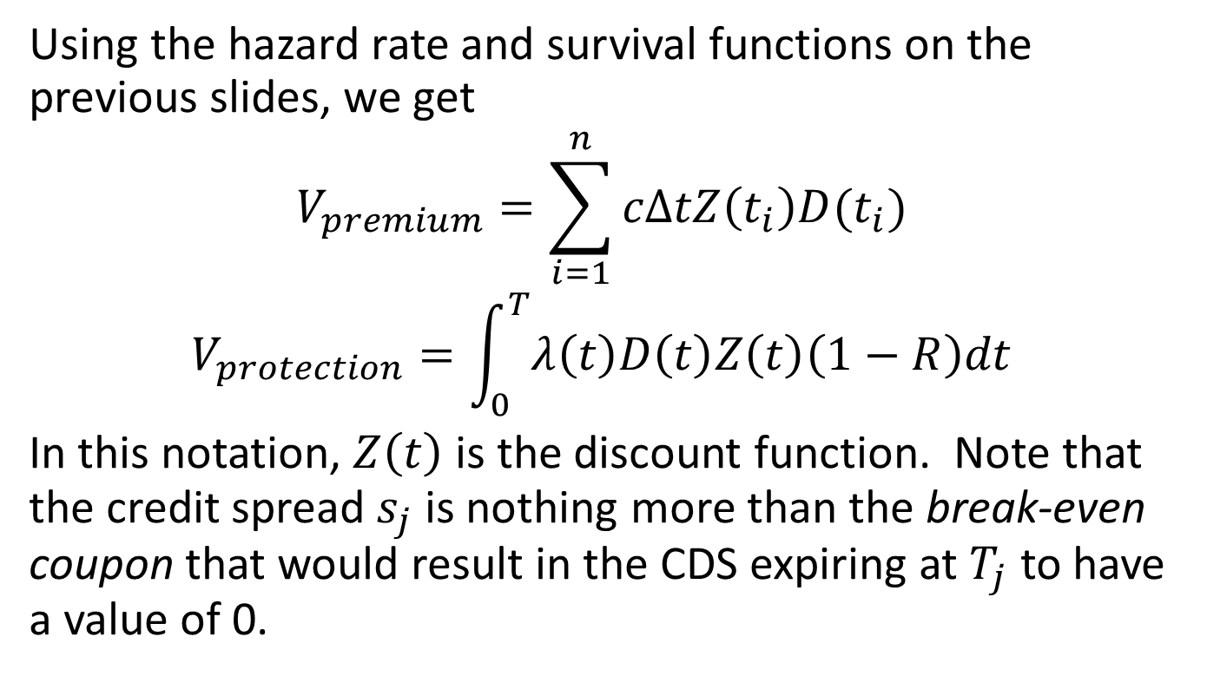
Valuing a CDS
Using the hazard rate and survival functions on the previous slides, we get
$$V_{premium}=\sum_{i=1}^{n}{cΔtZ\left(t_{i}\right)D(t_{i})}$$
$$V_{protection}=\int_{0}^{T}{λ\left(t\right)D\left(t\right)Z\left(t\right)\left(1−R\right)dt}$$
In this notation, $Z\left(t\right)$ is the discount function. Note that the credit spread $s_{j}$ is nothing more than the break-even coupon that would result in the CDS expiring at $T_{j}$ to have a value of 0.

Slide 37
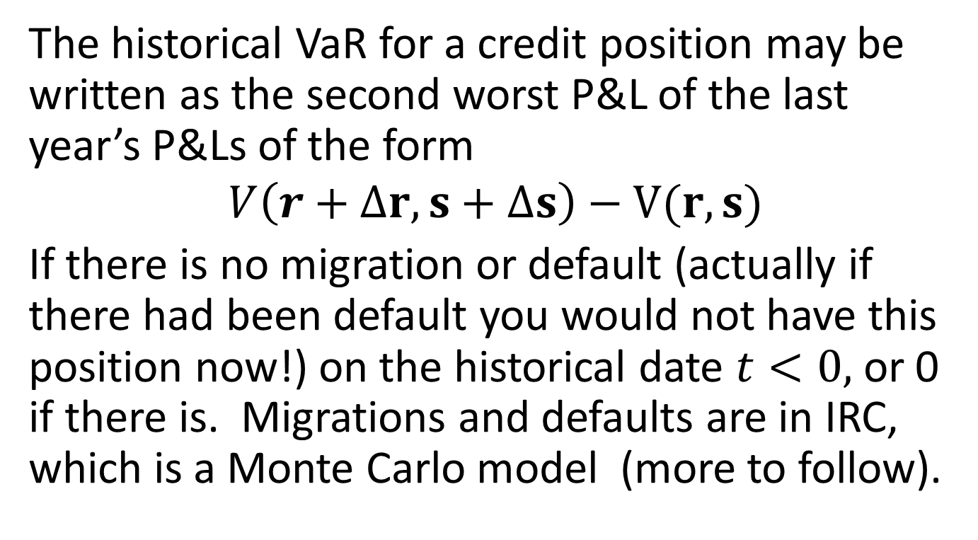
VaR for CDS
The historical VaR for a credit position may be written as the second worst P&L of the last year’s P&Ls of the form
$$V\left(r+Δr,s+Δs\right)−V(r,s)$$
If there is no migration or default (actually if there had been default you would not have this position now!) on the historical date $t<0,$ or 0 if there is. Migrations and defaults are in IRC, which is a Monte Carlo model (more to follow).

